Slide 1

TypeScript
Tahaluf Training Center 2021

Slide 2
Chapter 1
1
Overview about TypeScript
2
Why TypeScript?
3
Top frameworks and libraries that use TS
4
Installation and environment setup
5
VSCode Terminal
6
Difference between JS and TS
7
Type Annotations

Slide 3
Overview about Typescript
TypeScript is an open-source that builds on JavaScript.
TypeScript is pure object-oriented with classes, interfaces.
TypeScript allows you to type JavaScript the way you want.
In other words, TypeScript is JavaScript and has some additional features.

Slide 4
Overview about Typescript
Types provide a way to describe the structure of the object, provide better documentation, and allow TypeScript to validate that your code works correctly.
Writing types can be optional in TypeScript because type inference allows you to get a lot of power without writing additional code.

Slide 5
Chapter 1
1
Overview about TypeScript
2
Why TypeScript?
3
Top frameworks and libraries that use TS
4
Installation and environment setup
5
VSCode Terminal
6
Difference between JS and TS

Slide 6
Why Typescript?
Types TypeScript is not a fully loosely typed language like what we were doing in JS or Python, in TypeScript, we can assign a type for each variable, parameter, or even function.
The types are the usual ones in other programming languages, and we will get more deeply into them soon.

Slide 7
Why Typescript?
Support Object-Oriented Programming (OOP)
Typescript allows us to write Classes, Interfaces, Enums, Inheritances, Compositions, etc.
Better code modularization TypeScript allows us to create more organized modules and use them anywhere in our code.

Slide 8
Why Typescript?
Metaprogramming features like decorators
Decorators in Typescript are very much helpful, decorators mainly describe the piece of code below it and also can be used to manipulate specific data inside the code.

Slide 9
Chapter 1
1
Overview about TypeScript
2
Why TypeScript?
3
Top frameworks and libraries that use TS
4
Installation and environment setup
5
VSCode Terminal
6
Difference between JS and TS

Slide 10




Top frameworks and libraries that use TS

Slide 11
Chapter 1
1
Overview about TypeScript
2
Why TypeSccript?
3
Top frameworks and libraries that use TS
4
Installation and environment setup
5
VSCode Terminal
6
Difference between JS and TS

Slide 12
Installation and environment setup
To start working with Typescript we need to do the following steps:
Install Node.js + NPM (Node Package Manager).
Install TypeScript.
Install text-editor or IDE (integrated development environment), we will use VSCode in this course.

Slide 13
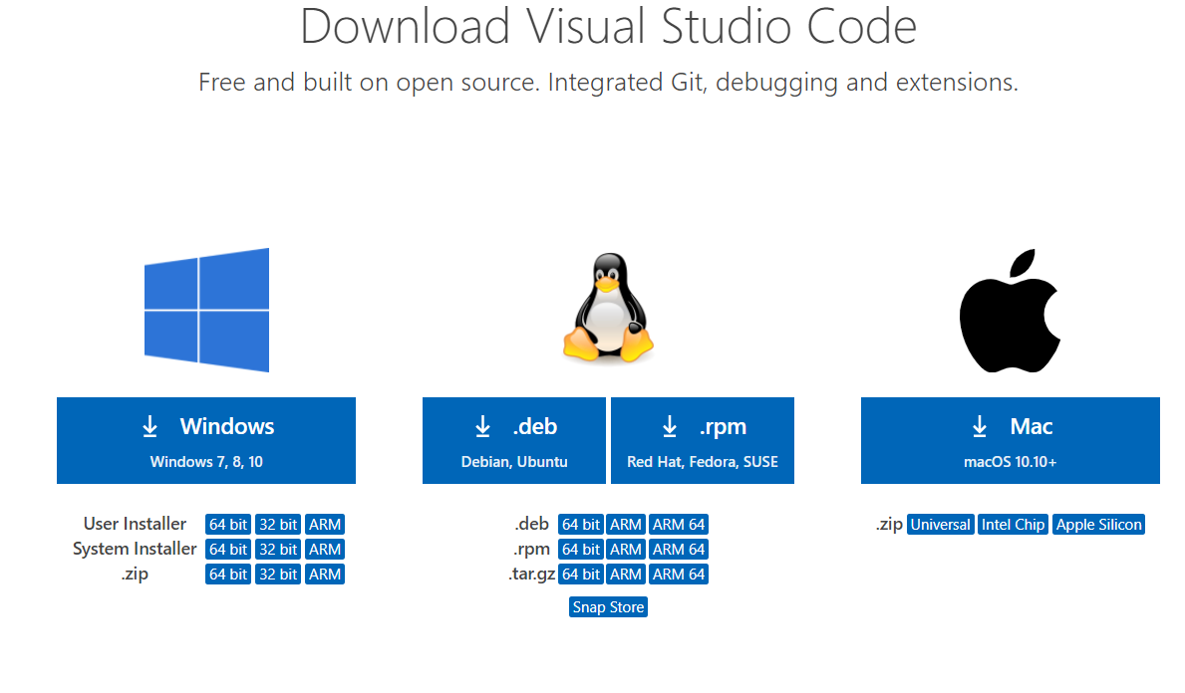
Installation and environment setup
First We need to install Visual Studio Code (VSCode).
Go to https://code.visualstudio.com/download and choose the right one for your device.

Slide 14
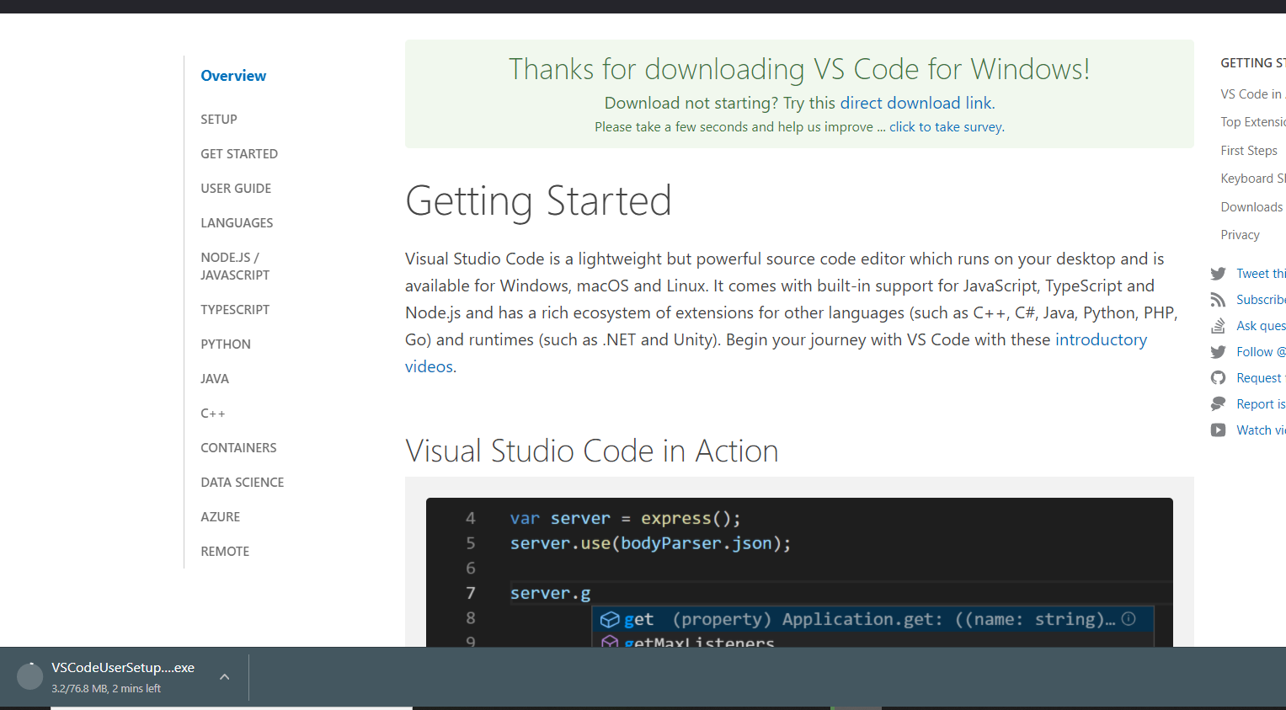
Installation and environment setup

Slide 15
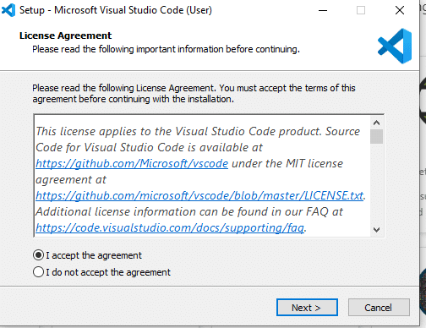
Installation and environment setup
Choose I accept the agreement and then click next .

Slide 16
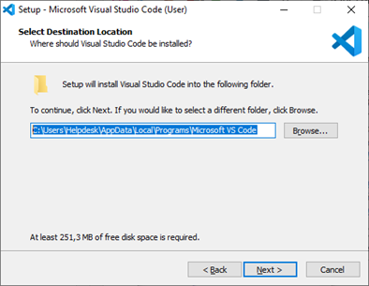
Installation and environment setup
Choose where you want to install the software. You can change the installation folder location, or keep the default settings. Click Next to continue.

Slide 17
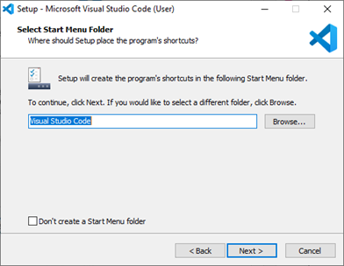
Installation and environment setup
If you want to change the shortcut folder name in your Start menu, or you don’t want to install shortcuts at all. Click Next.

Slide 18
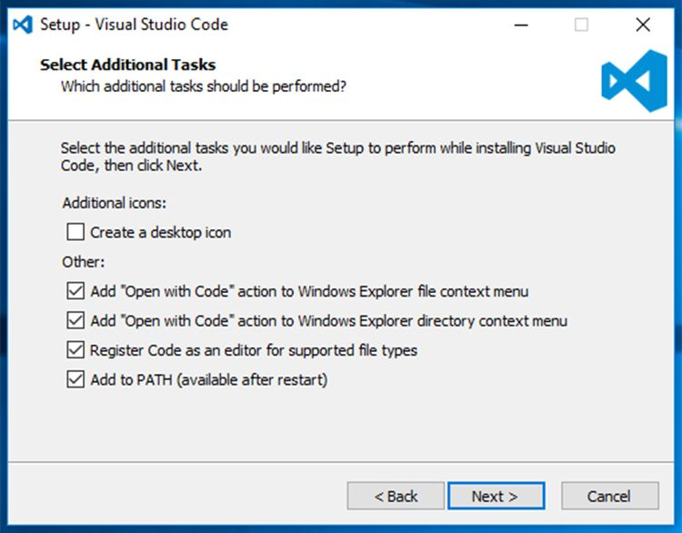
Installation and environment setup
Select the additional tasks, e.g. creating a desktop icon or adding options to the Windows Explorer right-click menu. Click Next.

Slide 19
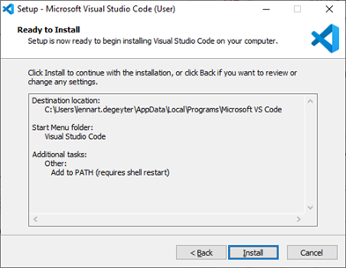
Installation and environment setup
Click Install to start the software installation.

Slide 20
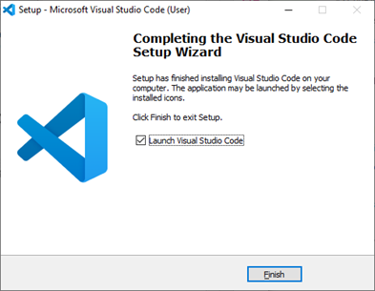
Installation and environment setup
Click Install. The software is installed and ready to use. Click Finish to finalize the installation and start the program.

Slide 21
Install TypeScript using NPM
The Node Package Manager is used to install the typescript packages on your local machine or on your project, It consists of a command line client, also called NPM.
Make sure you have Node.js install on your local machine.

Slide 22
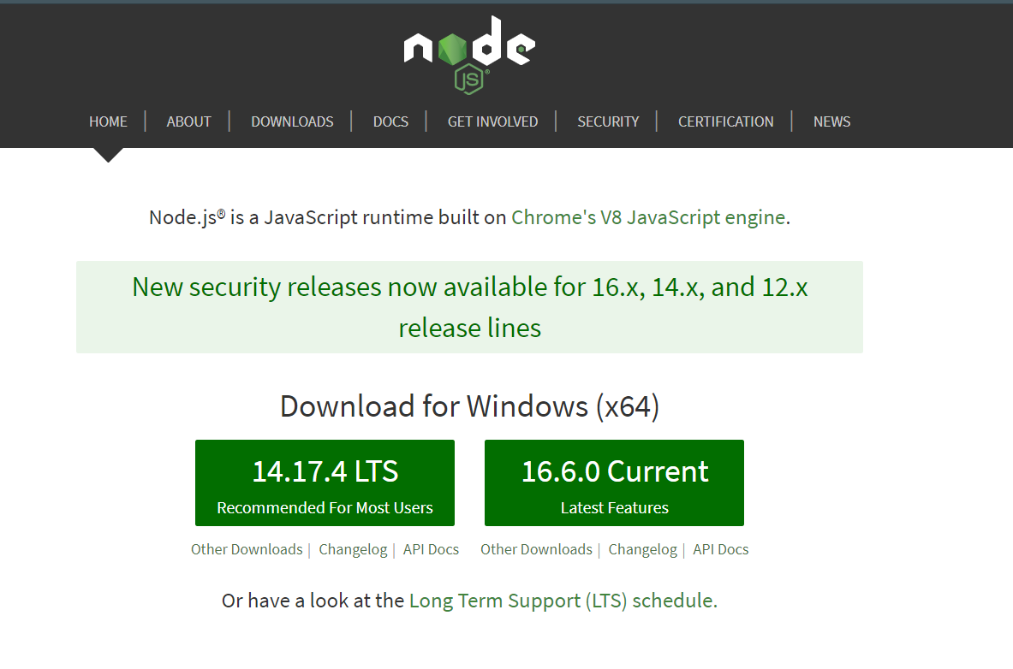
Install TypeScript using NPM
Next to Install Node.js and NPM (Node Package Manager).
Go to https://nodejs.org/en/

Slide 23
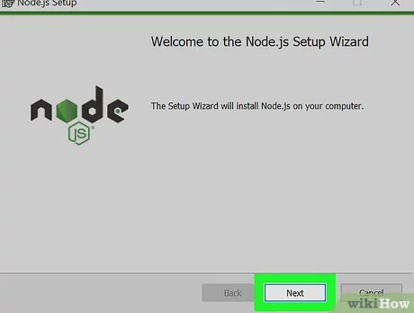
Install TypeScript using NPM
2. Click the "Next" button to continue with the installation.

Slide 24
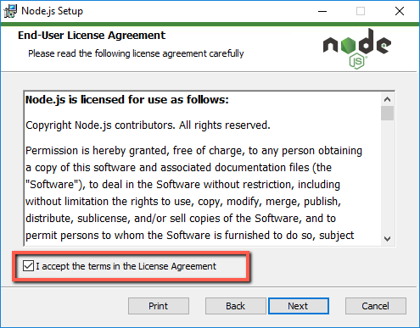
Install TypeScript using NPM
3. Accept the terms and conditions.

Slide 25
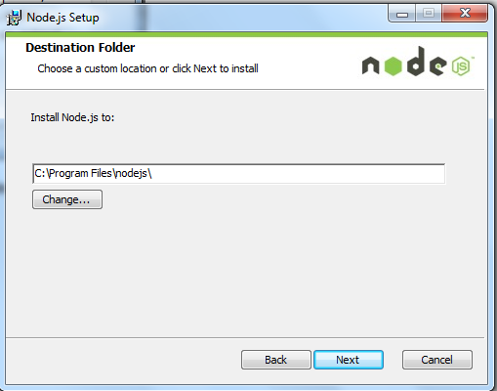
Install TypeScript using NPM
4. Choose the location where Node.js needs to be installed and then click on the Next button.

Slide 26
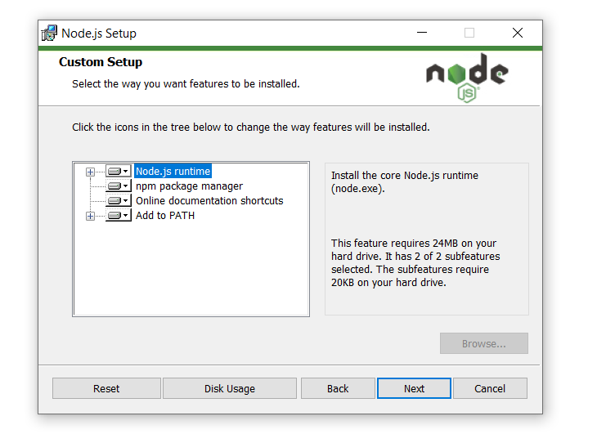
Install TypeScript using NPM
5. Select the default components to be installed, accept the default components and click on the Next button.

Slide 27
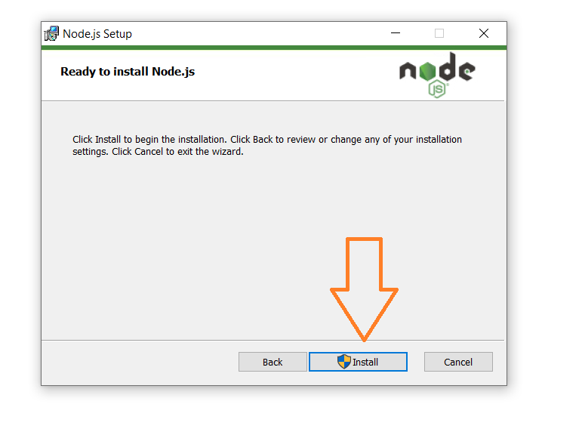
Install TypeScript using NPM
6. Start the installation.

Slide 28
Chapter 1
1
Overview about TypeScript
2
Why TypeScript?
3
Top frameworks and libraries that use TS
4
Installation and environment setup
5
VSCode terminal
6
Difference between JS and TS

Slide 29
VSCode Terminal
To get the better advantages of this course we will use the terminal to create our files, install packages and also run and build our code.
To open the terminal on VSCode you can do Ctrl + J on Windows or Cmd + J on OSX.

Slide 30
VSCode Terminal
The main commands:
cd (to navigate through files).
touch <file name> (to create files) for MAC
and dir > <file name> for WINDOWS.
mkdir <folder name> (to create folder).
Other commands will be discussed throughout the course.

Slide 31
VSCode Terminal
We will start building our TS code to JS code then run it on the browser.
And we will do all that using the tsc command which comes with the typescript itself, so basically when you install typescript you become able to use the tsc on any ts project.

Slide 32
VSCode Terminal
To initialize the TS project, we will use:
1- npm init
2- tsc --init
Using these commands we will have two new files the package.json file and tsconfig file, These files will help us manage our ts configurations like linting and compilation options, package.json will help us tracking and using our packages.

Slide 33
VSCode Terminal
To Install TypeScript on your local machine:
Open the terminal.
Write this command :
npm install -g typescript (-g means global).

Slide 34
Chapter 1
1
Overview about TypeScript
2
Why Typescript?
3
Top frameworks and libraries that use TS
4
Installation and environment setup
5
VSCode Terminal
6
Difference between JS and TS

Slide 35
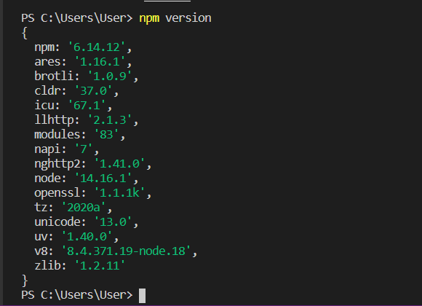
Difference between JS and TS
Check the installed version using the following command:

Slide 36
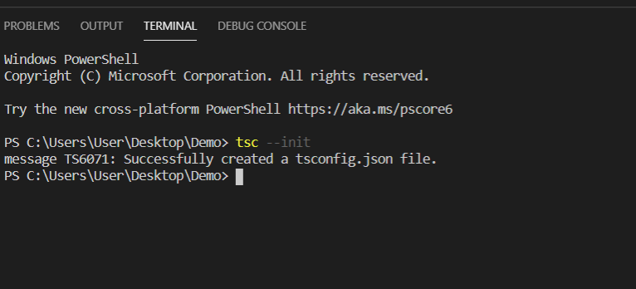
Difference between JS and TS
To add tsconfig.json file by using tsc --init command.

Slide 37
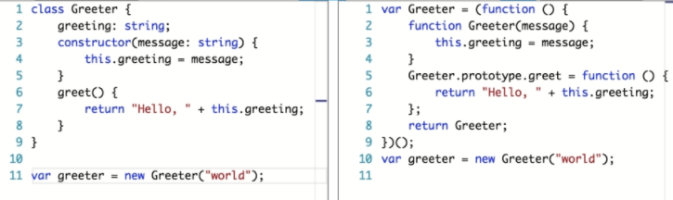
Difference between JS and TS
How to transform the typescript file to JavaScript file after using tsc command.
Typescript JavaScript after transformation

Slide 38
Difference between JS and TS
In typescript, We can specify the type using: Type after the name of the variable, parameter, or property. There can be a space after the colon.
TypeScript includes all the primitive (value) types of JavaScript- number, String and Boolean.

Slide 39
Difference between JS and TS
Example:
var age: number = 32; // number variable
var name: string = "Dana"; // string variable
var isUpdated: boolean = true; // Boolean variable

